Slide 1
Refactoring
Dragoș Petrașcu
Software Architect
Fortech, a GlobalLogic Company

Slide 2
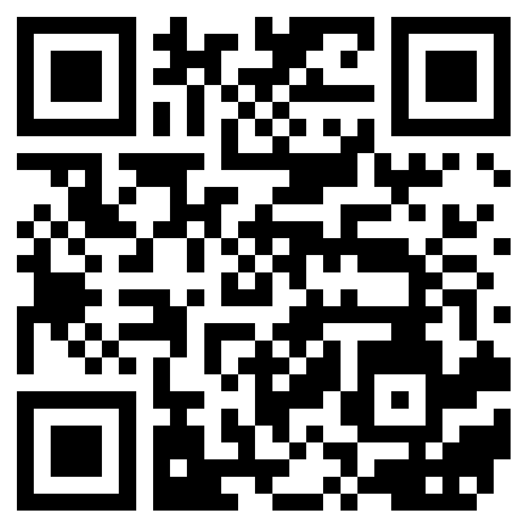
About me
https://www.linkedin.com/in/dragospetrascu/

Slide 3
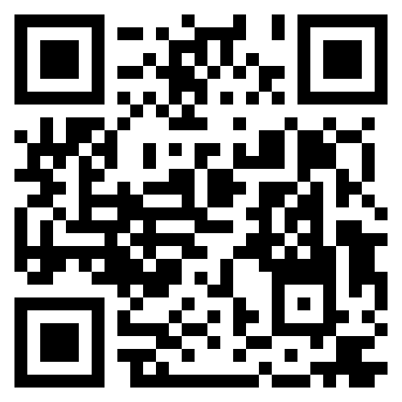
Manifesto for Agile Software Development
https://agilemanifesto.org/

Slide 4
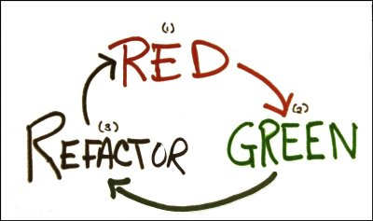
TDD Cycle
Create a unit test that fails.
Write production code that makes that test pass.
Clean up the mess you just made.
Getting software to work is only half of the job.

Slide 5
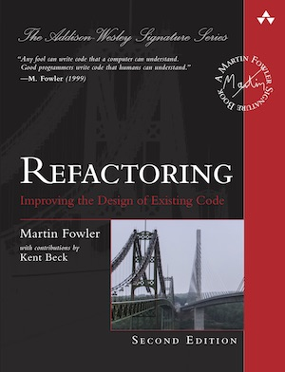
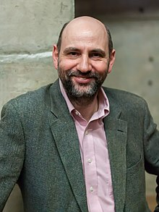
Refactoring Improving the Design of Existing Code

Slide 6
About Refactoring
Refactoring is a crucial process in software development that involves making incremental and disciplined improvements to existing code without altering its external behavior.
It aims to enhance code quality, maintainability, and readability by restructuring it, eliminating redundancies, and optimizing its design.
Refactoring is not about adding new features but rather about making the code more efficient and understandable.
This practice is essential for keeping software systems agile and adaptable as they evolve over time, preventing the accumulation of technical debt and ensuring that the codebase remains clean and easy to work with.
By continuously refactoring code, developers can streamline their work, reduce the risk of introducing bugs, and make it easier to accommodate changing requirements, ultimately leading to more robust and maintainable software.

Slide 7
Hot topics
Refactoring Tools: Utilizing refactoring tools provided by integrated development environments (IDEs) to automate and facilitate the refactoring process.
Renaming: Using descriptive and meaningful names for variables, functions, and classes to improve code clarity.
Move Method and Move Field: Relocating methods and fields to more appropriate classes to ensure proper encapsulation and organization.
Extract Method: Breaking down a long or complex method into smaller, more manageable methods to improve readability and maintainability.
Inline Method: Removing a method if it has become unnecessary or redundant, simplifying the code.
Extract Variable: Replacing complex expressions with well-named variables to enhance code readability.
Extract Class: Moving a group of related fields and methods into a separate class to reduce the complexity of the original class and promote modularity.
Introduce Design Patterns: Applying established design patterns to address common design problems and improve code structure.

Slide 8
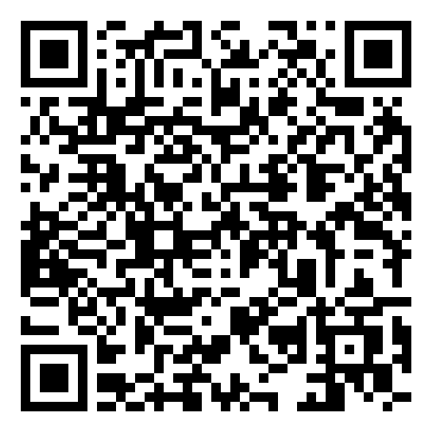
Live coding session
https://github.com/fortech-practice/utcn-2023-11-27-refactoring

Slide 9


Slide 10

FEEDBACK FORM

Slide 11
+40 264 453 303
dragos.petrascu@globallogic.com
www.fortech.ro

